Slide 1
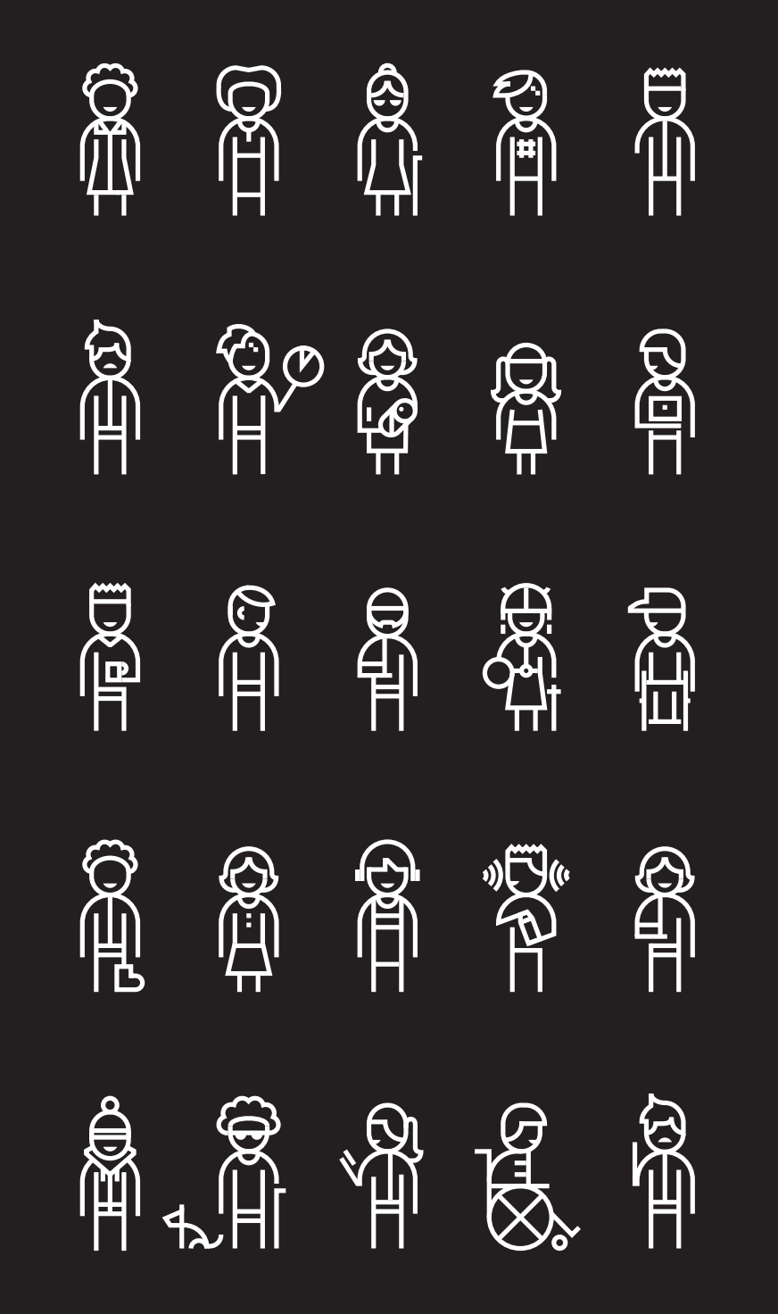
The Journey to Accessible Apps
Rachel Kang (she/her)
Software Engineer, .NET MAUI
@CPTMSDUG

Slide 2




Hi, I’m Rachel!
I work on .NET MAUI
I love eating, reading, and exploring (foodsta is @nomonayum)
I’m passionate about all things accessibility and inclusive design
My first presentation as a full-time professional was at CPTMSDUG 3 years ago!
@therachelkang
@rachelkang
https://www.linkedin.com/in/rachel-j-kang

Slide 3
The Journey to Accessible Apps
Accessible
Accessible Apps
The Journey to Accessible Apps

Slide 4
The Journey to Accessible Apps
What does it mean to be accessible?
Why should you care?

Slide 5
Over 1 billion people currently experience some form of disability
Over 1 billion people currently experience some form of disability

Slide 6
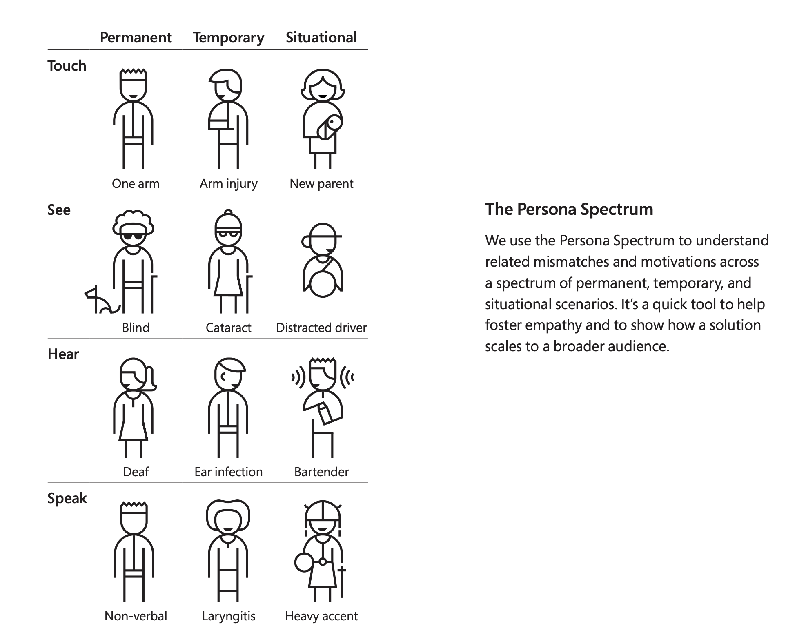
The Persona Spectrum
https://inclusive.microsoft.design/tools-and-activities/Inclusive101Guidebook.pdf

Slide 7
The best solutions benefit everyone
Designing for accessibility is not limited to people experiencing disabilities
The best solutions benefit everyone

Slide 8
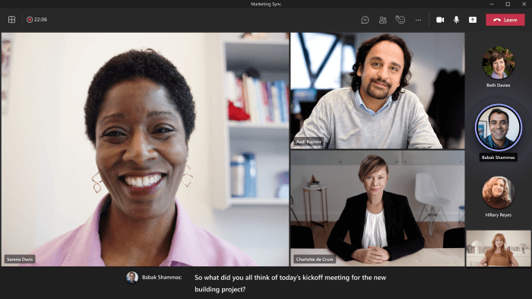
Teams captions

Slide 9
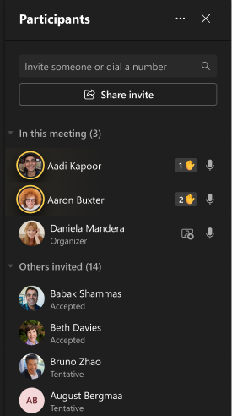
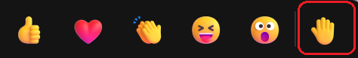
Teams raise hand

Slide 10
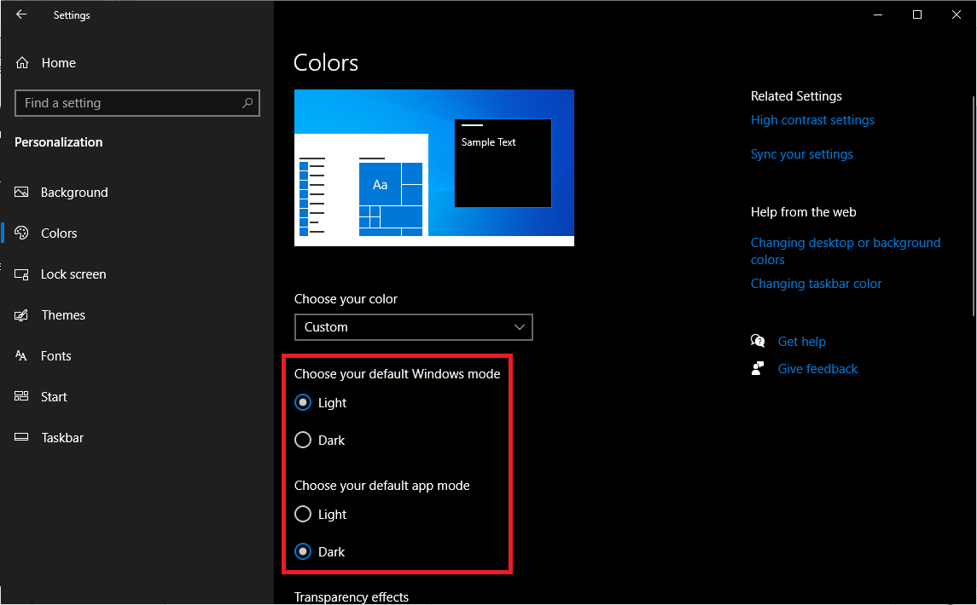
Windows system themes

Slide 11
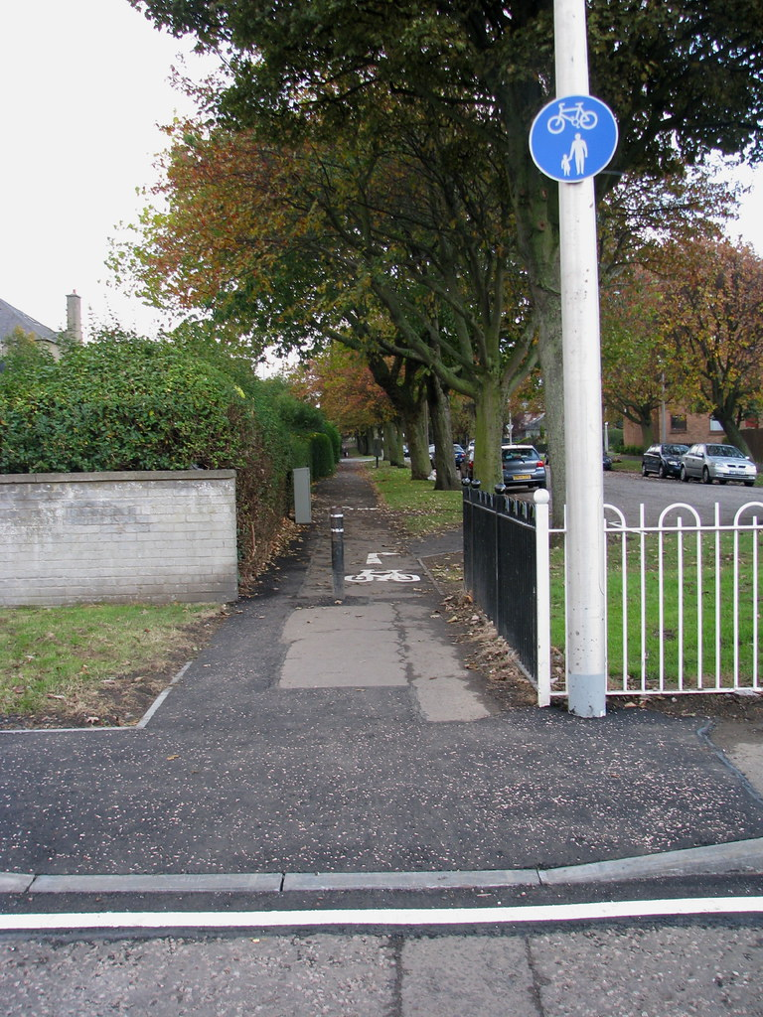
Curb cut

Slide 12
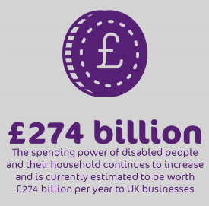
The purple pound
Huge business opportunity
worth hundreds of billions
https://wearepurple.org.uk/the-purple-pound-infographic

Slide 13
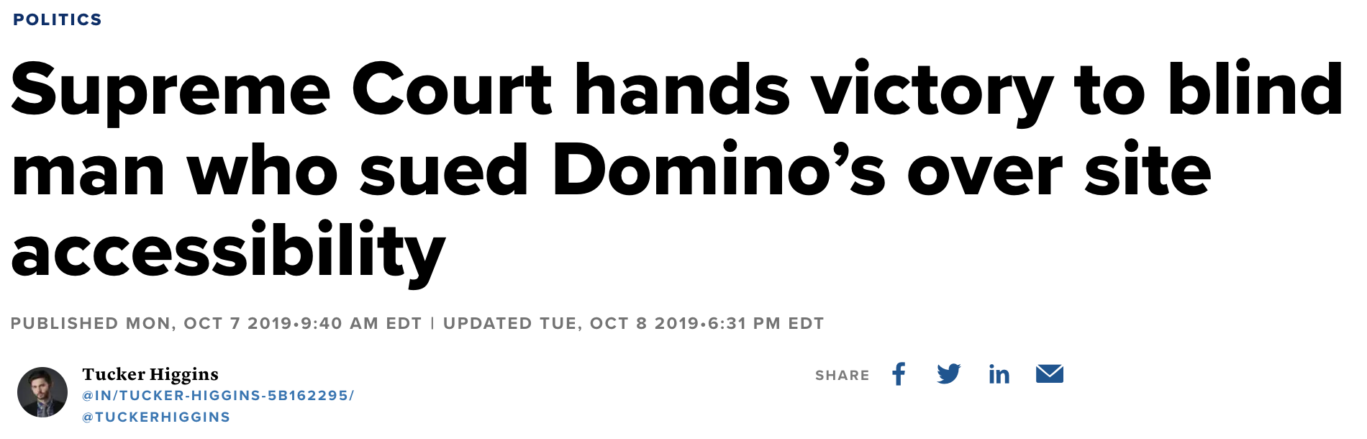
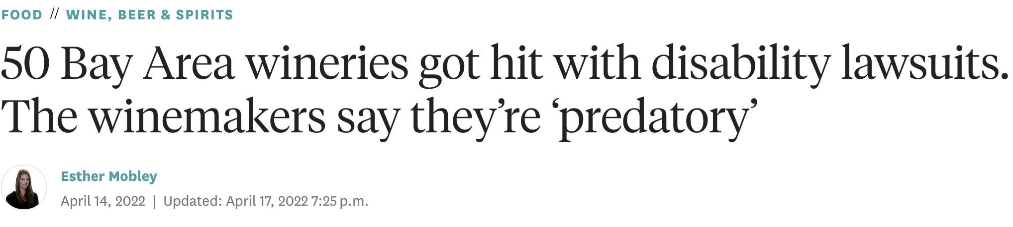
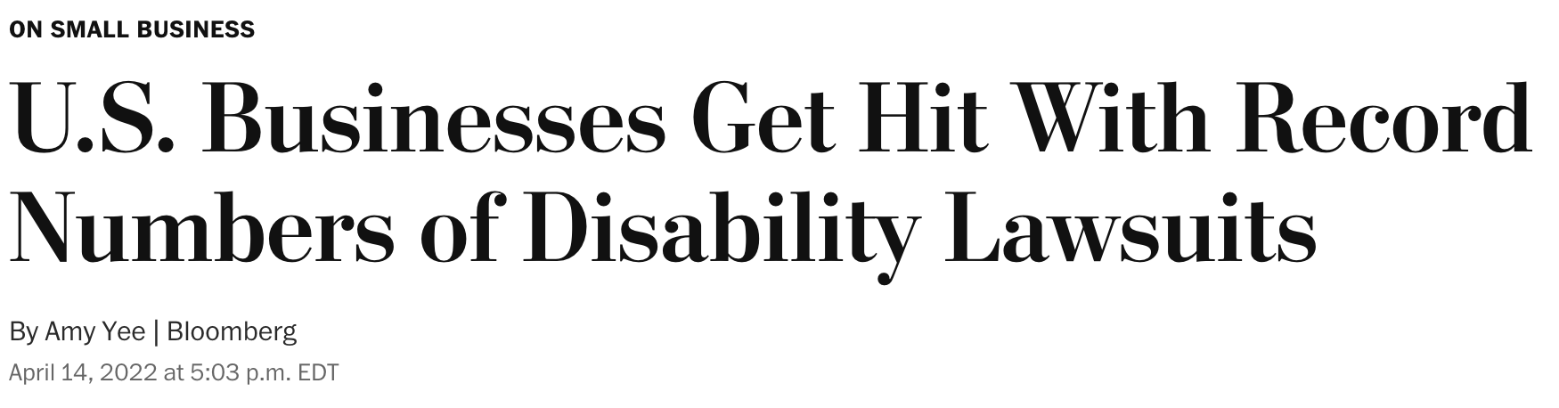
Legal consequences
Growing number of
legal consequences

Slide 14
The Journey to Accessible Apps
What makes our apps accessible?

Slide 15
Inclusive Design Principles
Provide comparable experience
Consider situation
Be consistent
Give control
Offer choice
Prioritize content
Add value
https://inclusivedesignprinciples.org

Slide 16
Inclusive Design Principles
Provide comparable experience → i.e. content for alternatives
Consider situation → i.e. color contrast
Be consistent → i.e. consistent design patterns
Give control → i.e. allow zoom
Offer choice → i.e. accessible alternatives
Prioritize content → i.e. prioritizing tasks
Add value → i.e. make task completion easier
https://inclusivedesignprinciples.org

Slide 17
Web Content Accessibility Guidelines
Global a11y standard and legal benchmark for both web and mobile
1 – Perceivable Information and user interface components must be presentable to users in ways they can perceive. | 2 – Operable User interface components and navigation must be operable. | 3 – Understandable Information and the operation of user interface must be understandable. | 4 – Robust Content must be robust enough that it can be interpreted by a wide variety of user agents, including assistive technologies.
1.1 - Text alternatives 1.2 - Time-based media 1.3 - Adaptable 1.4 - Distinguishable | 2.1 - Keyboard accessible 2.2 - Enough time 2.3 - Seizures and physical reactions 2.4 - Navigable 2.5 - Input modalities | 3.1 - Readable 3.2 - Predictable 3.3 - Input assistance | 4.1 - Compatible
https://www.w3.org/WAI/standards-guidelines/WCAG

Slide 18
The Journey to Accessible Apps
How do we put these insights into practice?
How do you design and develop accessible apps?
How do you test apps for accessibility?

Slide 19
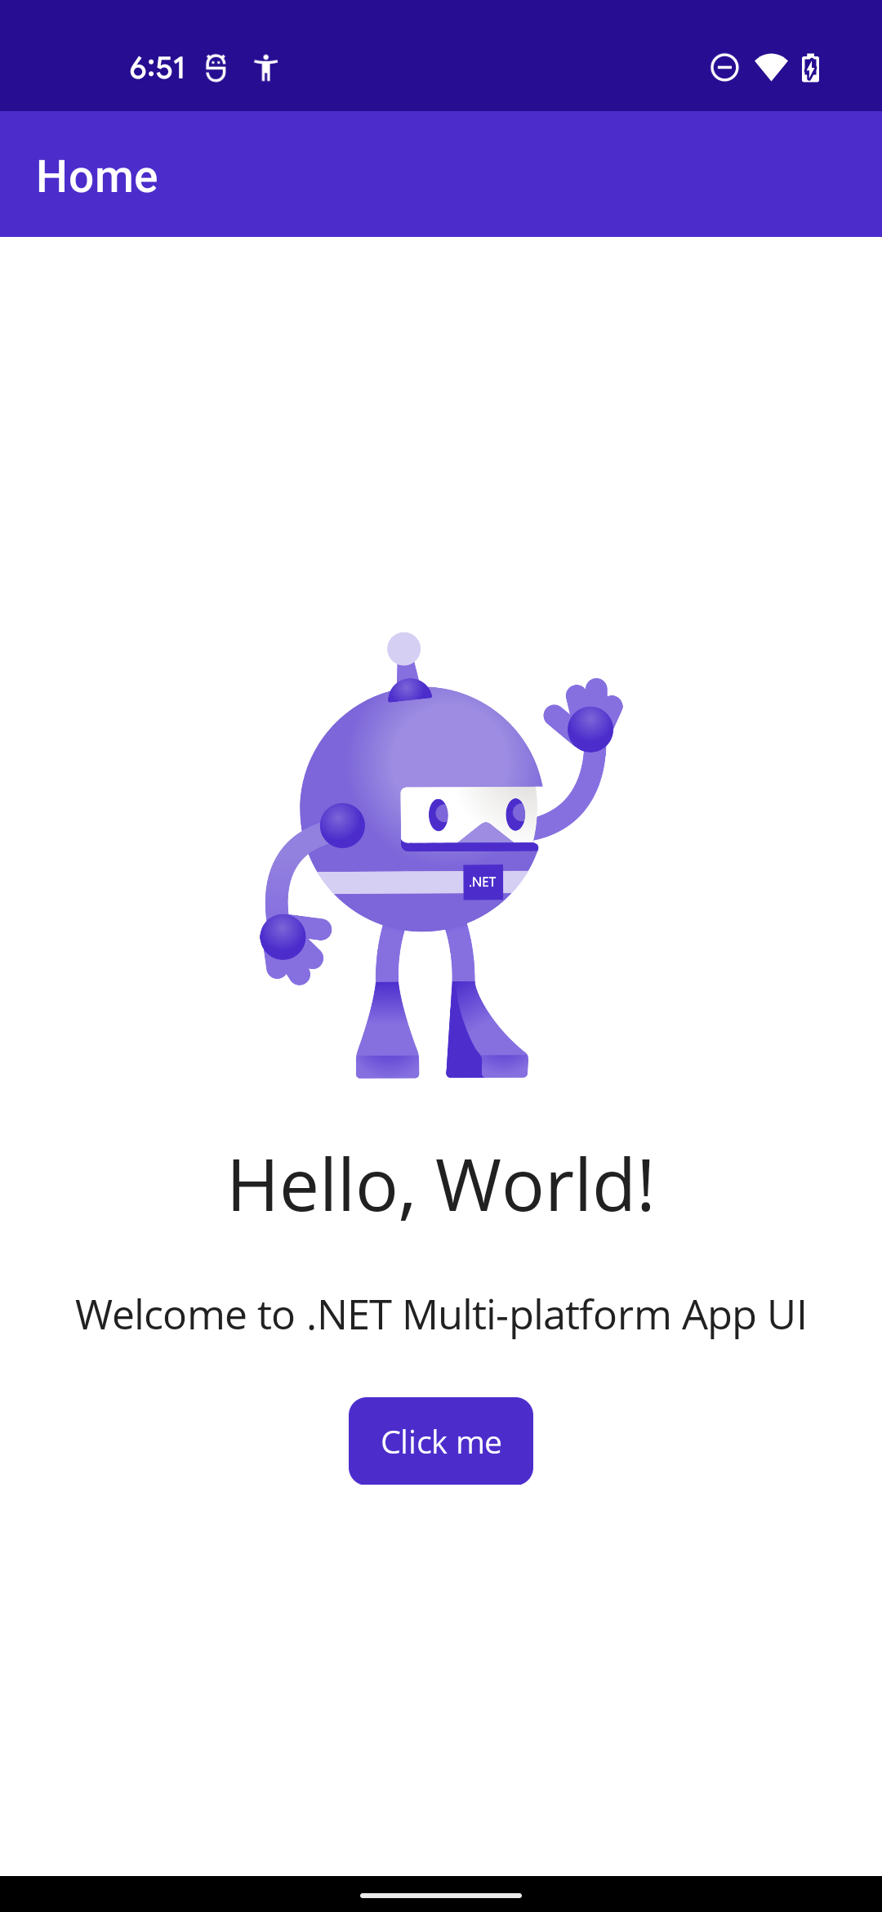
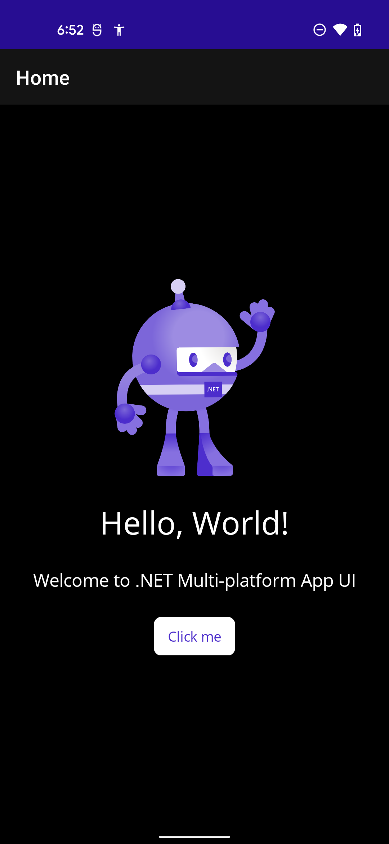
Design & Develop
Color Contrast
https://webaim.org/resources/contrastchecker
App Theming
Dark mode
Light mode
High contrast mode

Slide 20
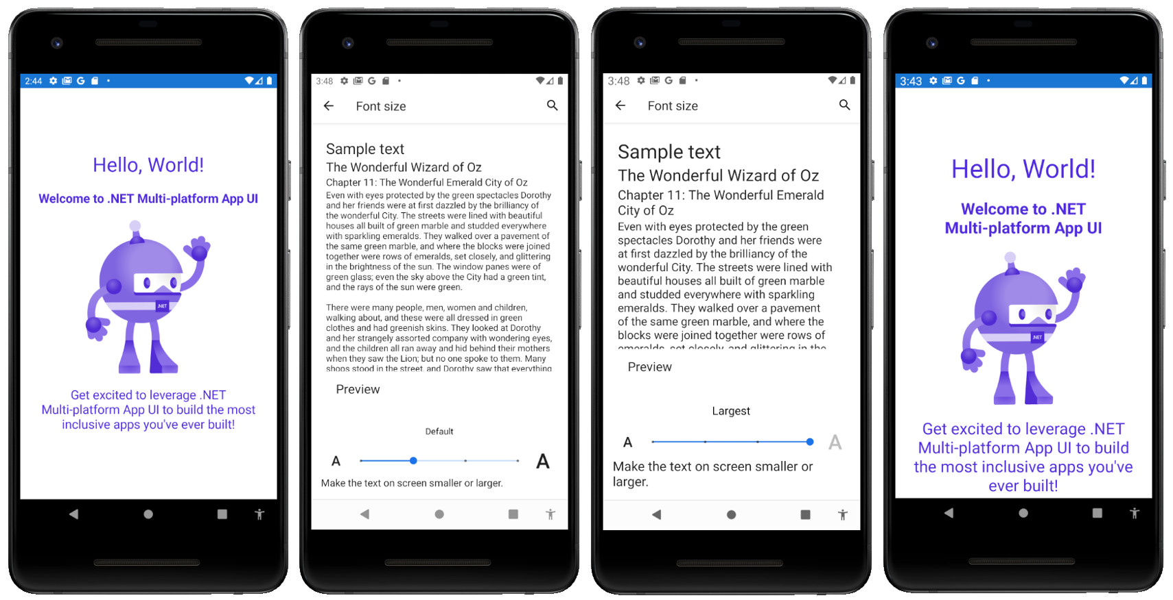
Design & Develop
Font size auto-scaling

Slide 21
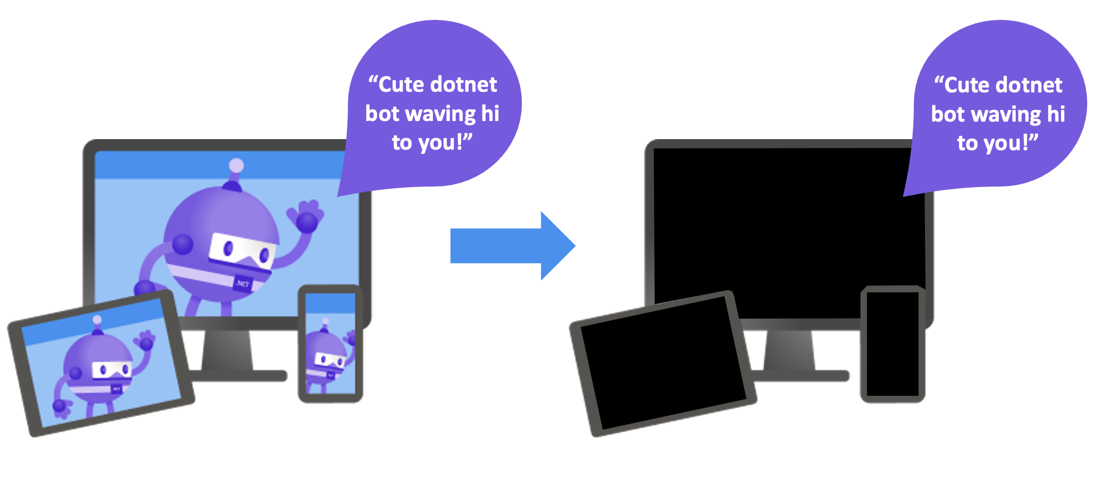
Design & Develop
Screen reader compatibility, especially for images and icons

Slide 22
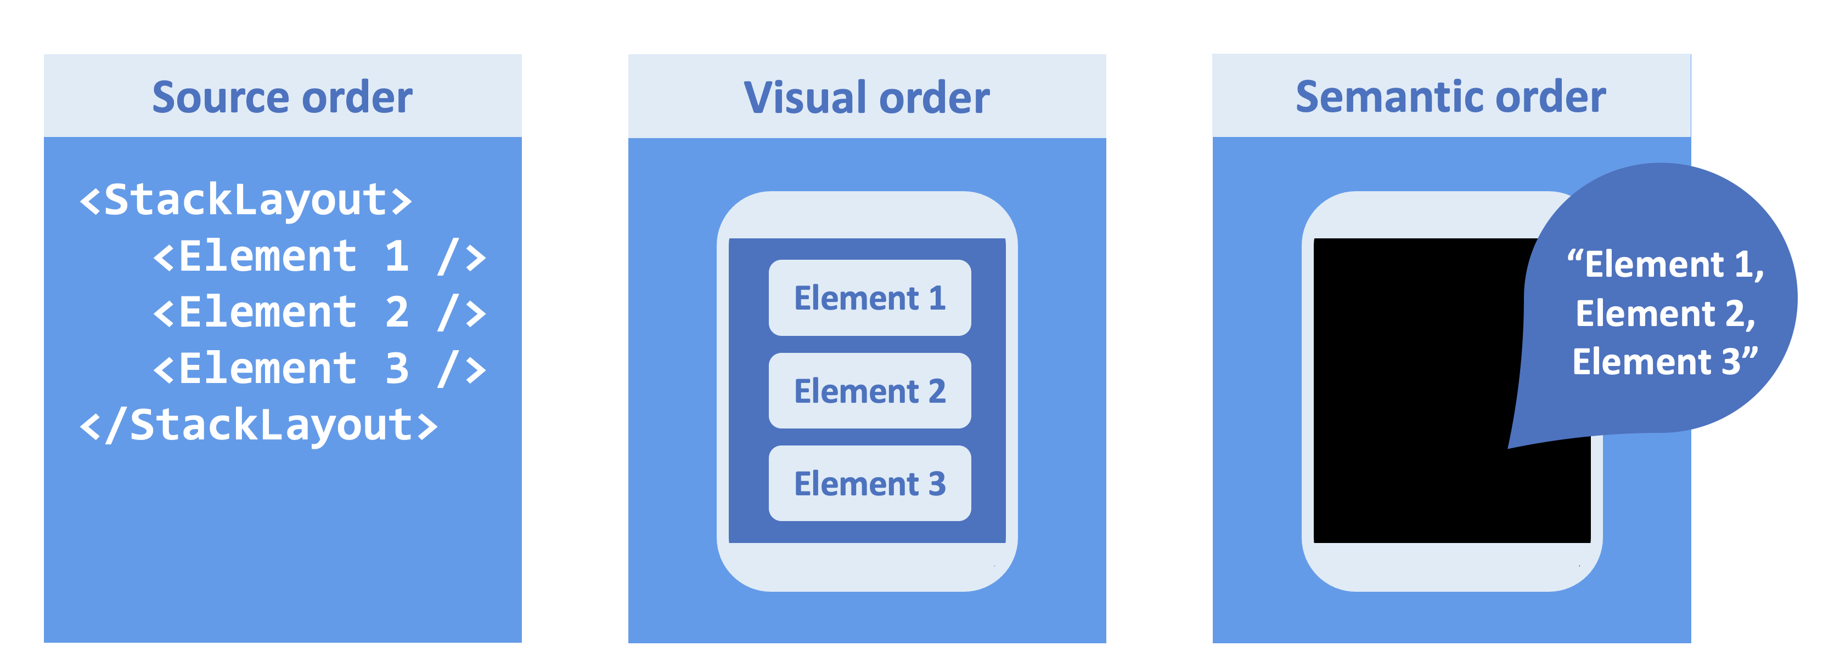
Design & Develop
Meaningful content ordering

Slide 23
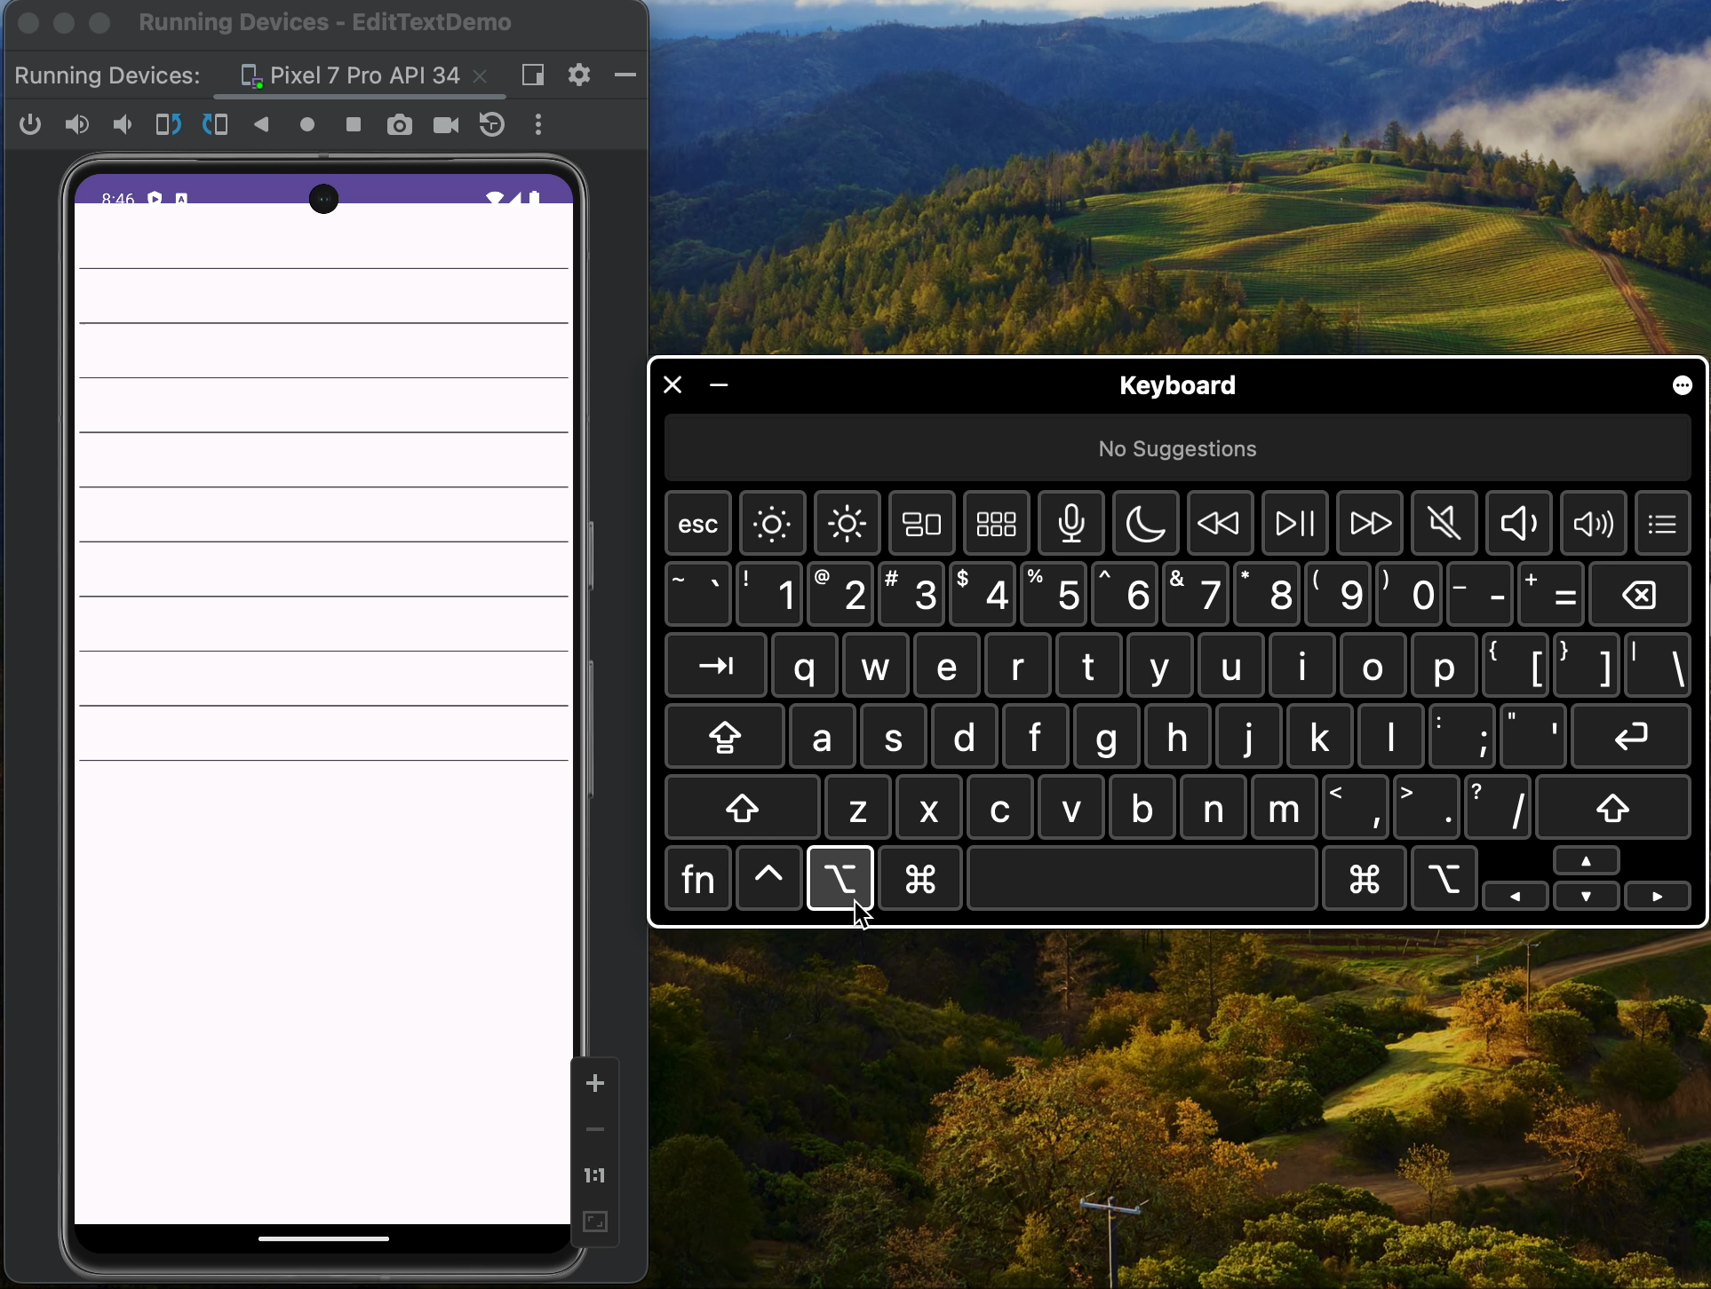
Design & Develop
Keyboard accessibility
Guideline 2.1 – Keyboard Accessible: Make all functionality available from a keyboard.
Focus
Navigation
Tab
Arrow keys
Shortcuts

Slide 24
Test
Ensure both Automated AND Manual test coverage
Write all the automated tests possible
Unit tests, UI tests
Use all the tools at your disposal
Accessibility Checker in Visual Studio
Accessibility Insights

Slide 25
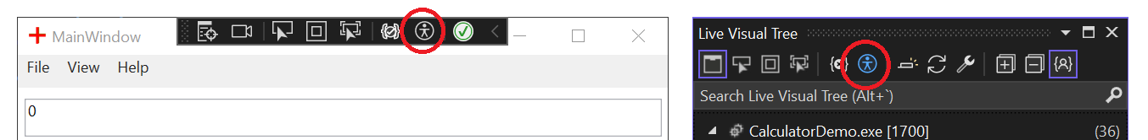
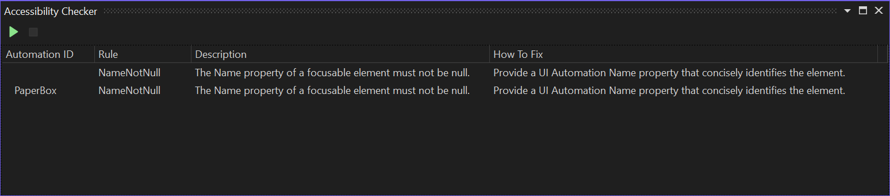
Accessibility Checker

Slide 26
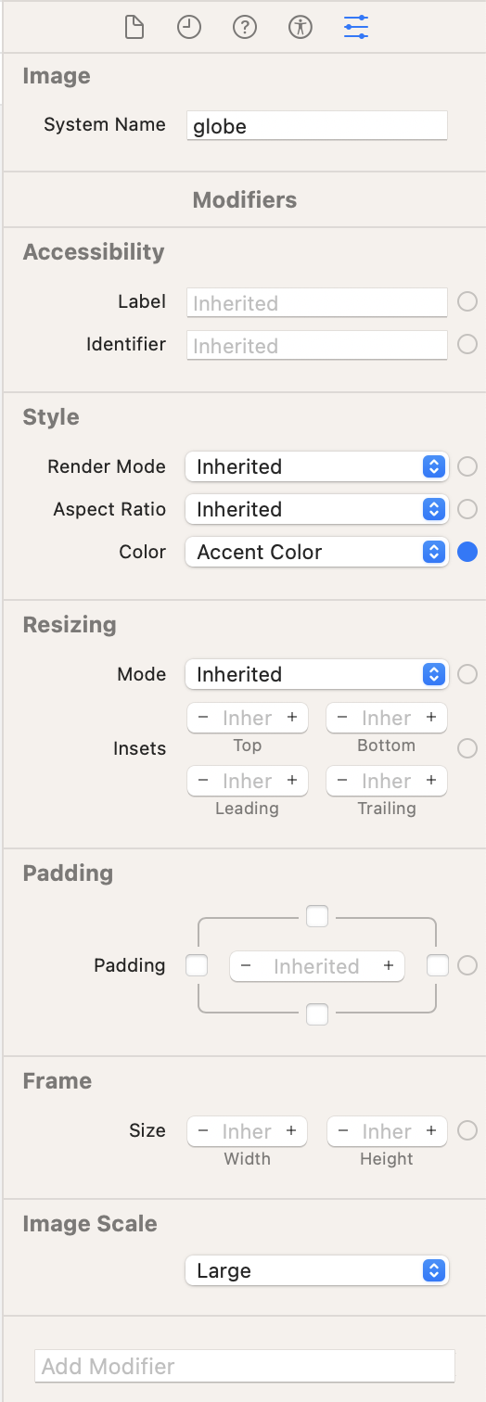
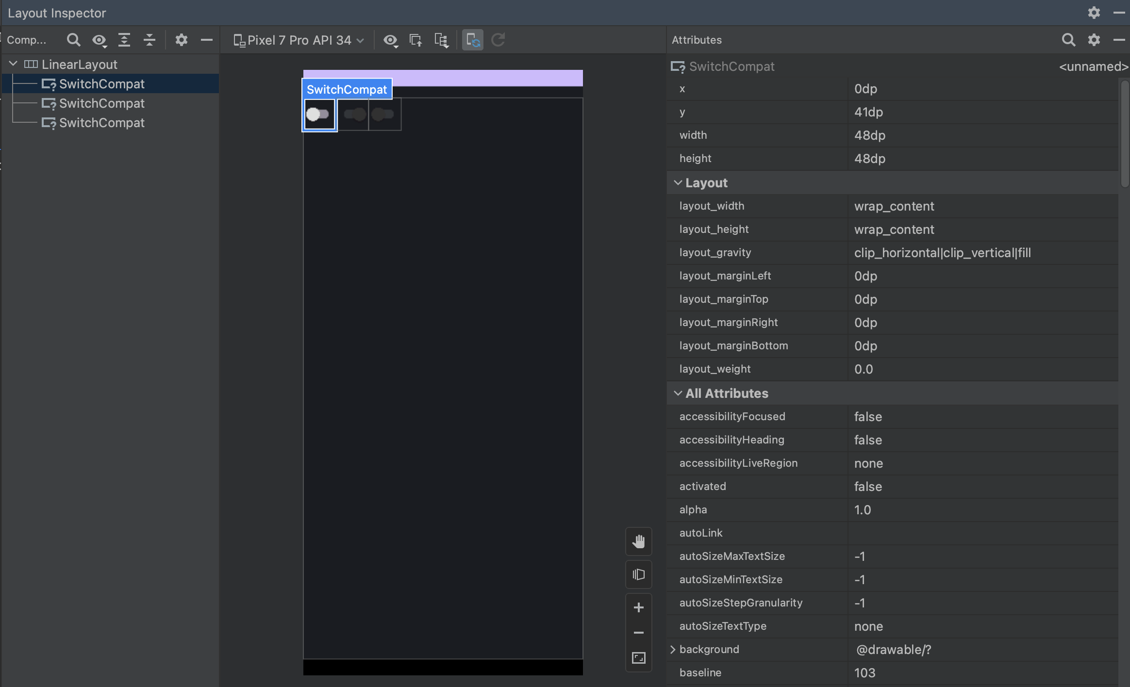
Android Layout Inspector and Xcode Attributes

Slide 27
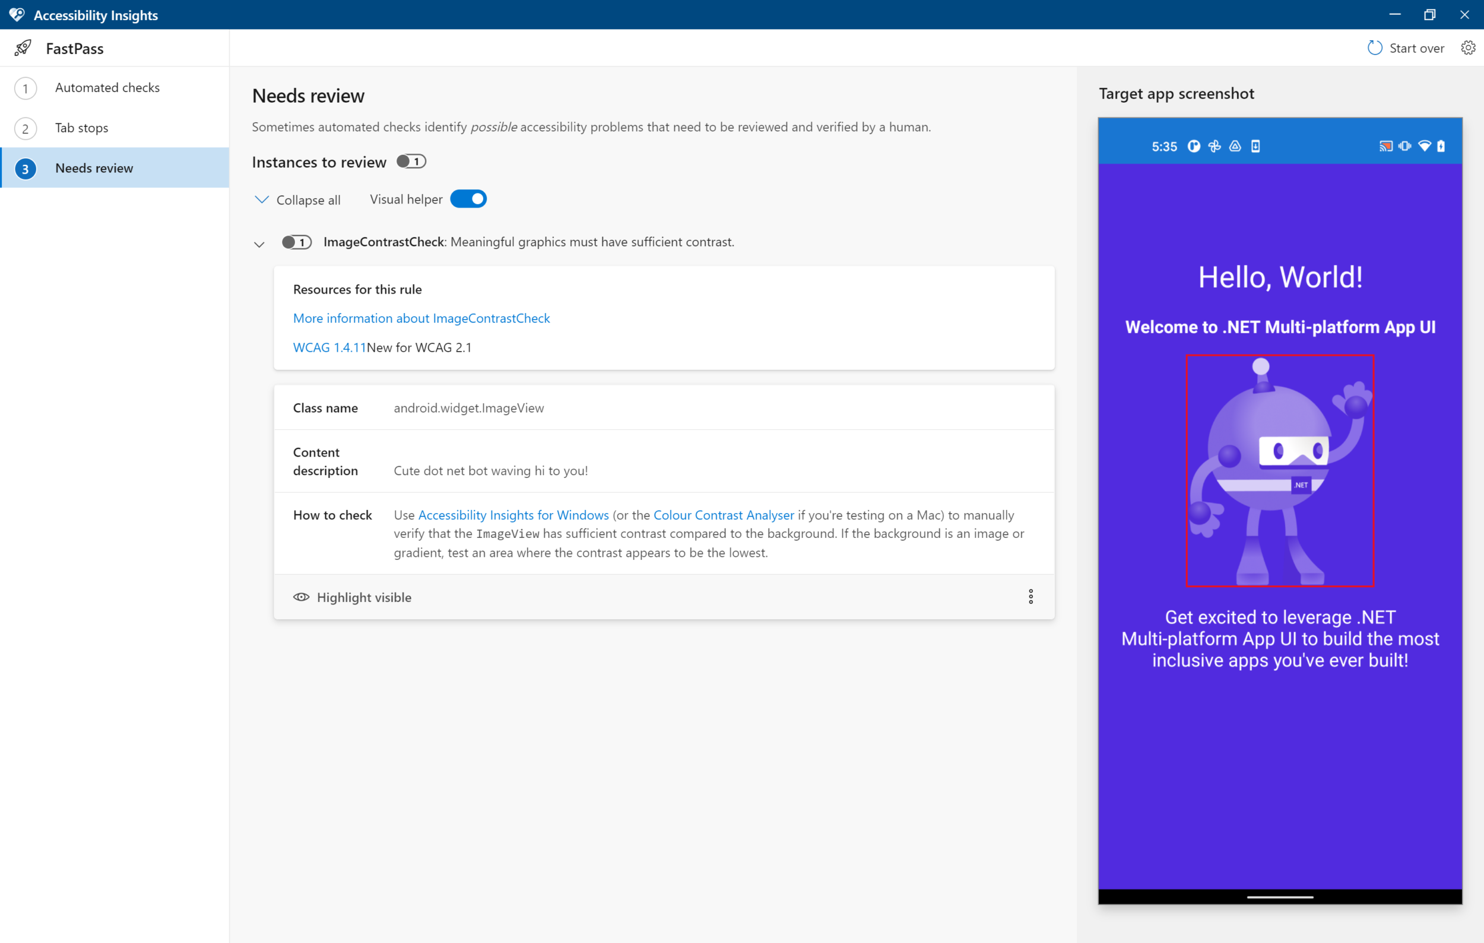
Accessibility insights: before

Slide 28
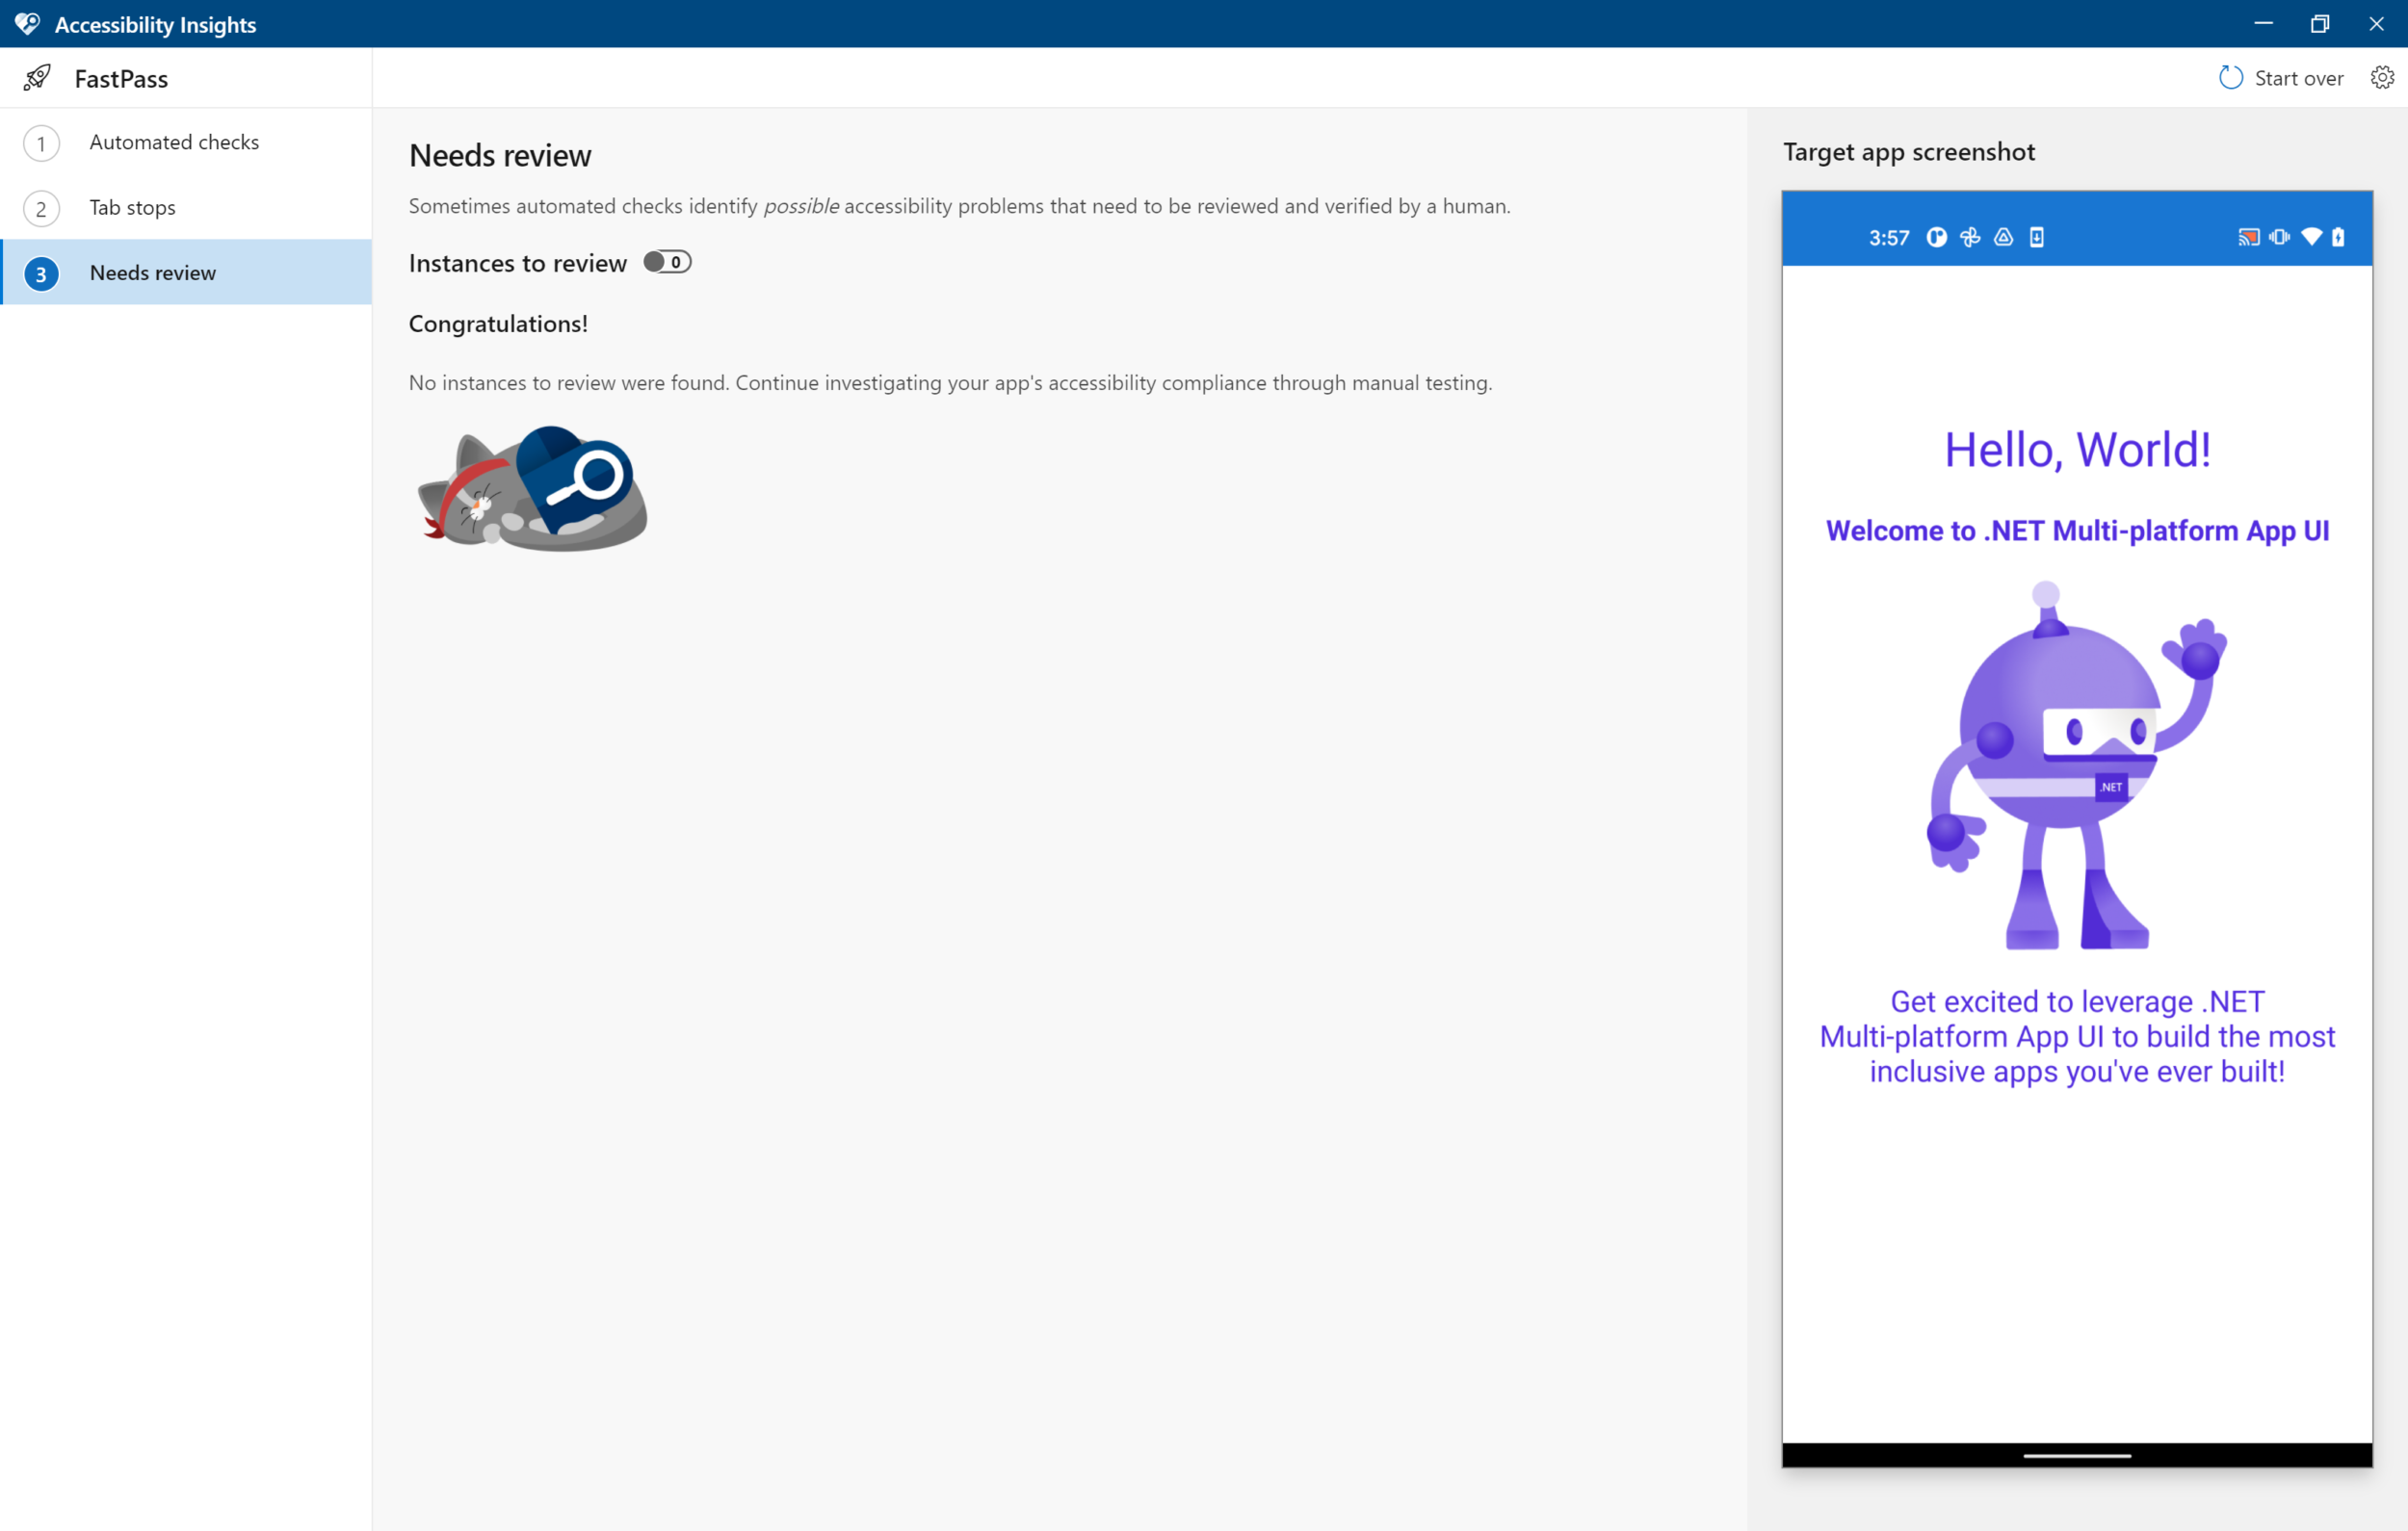
Accessibility insights: after

Slide 29
Test
Manually run through the app yourself
Have the experts manually run through your app too
Design manual test cases and run them regularly
Work with accessibility experts and testers to get your app validated for accessibility through a more comprehensive process

Slide 30
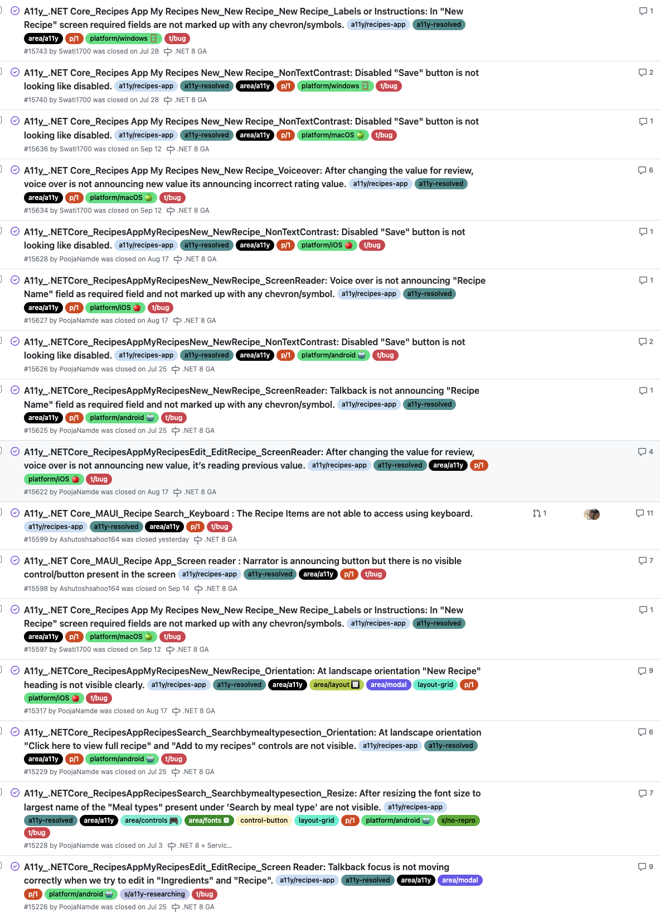
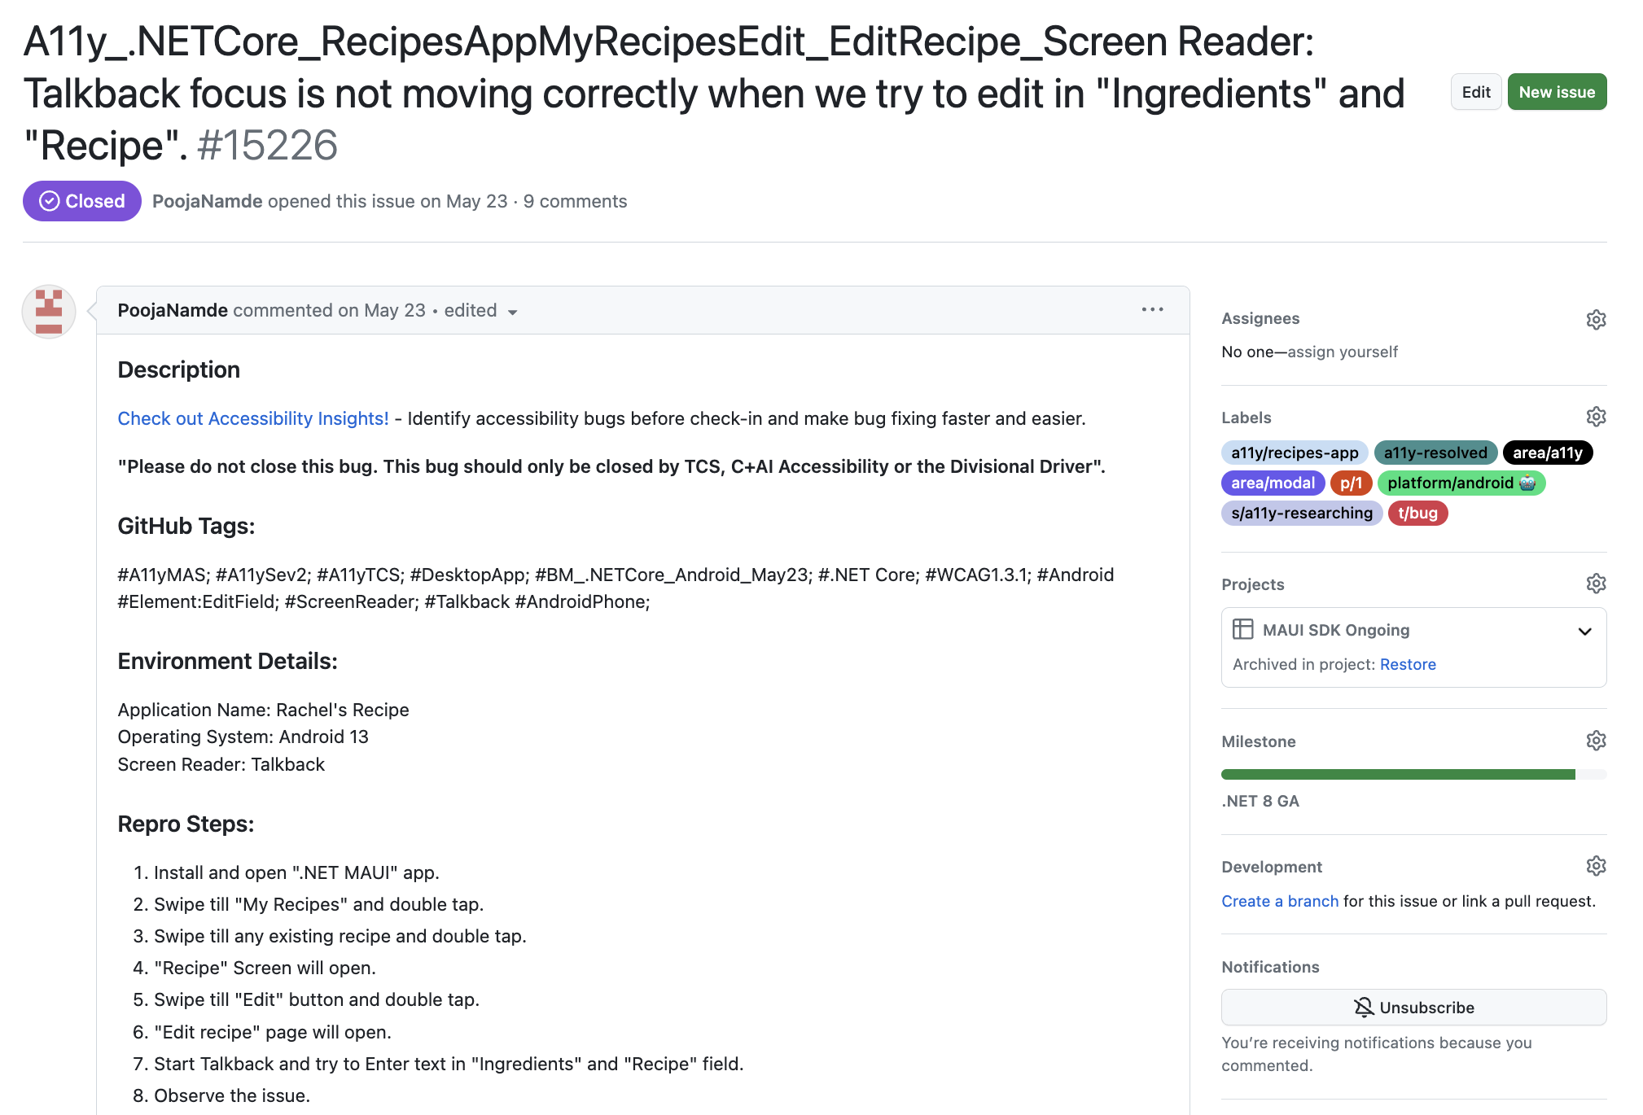
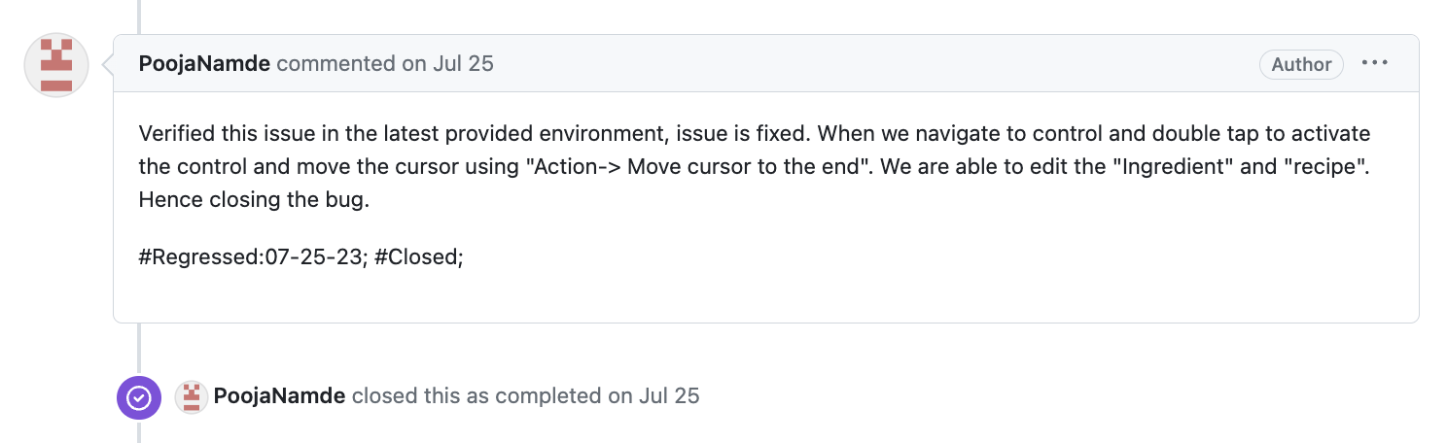
.NET MAUI manual test process

Slide 31
The journey continues
The journey to accessible apps continues

Slide 32
Empathy is key
The Journey to Accessible Apps
Empathy is the name of the game
Explore accessibility settings and features
Screen readers
VoiceOver (iOS, Mac); TalkBack (Android); Narrator (Windows)
NVDA, JAWS (third party Windows)
Input modalities
Keyboard, Pointer, Touch, Voice, Eye gaze, etc.
Research accessibility models and APIs
.NET MAUI semantic properties and extensions
Stay up to date on the latest!

Slide 33
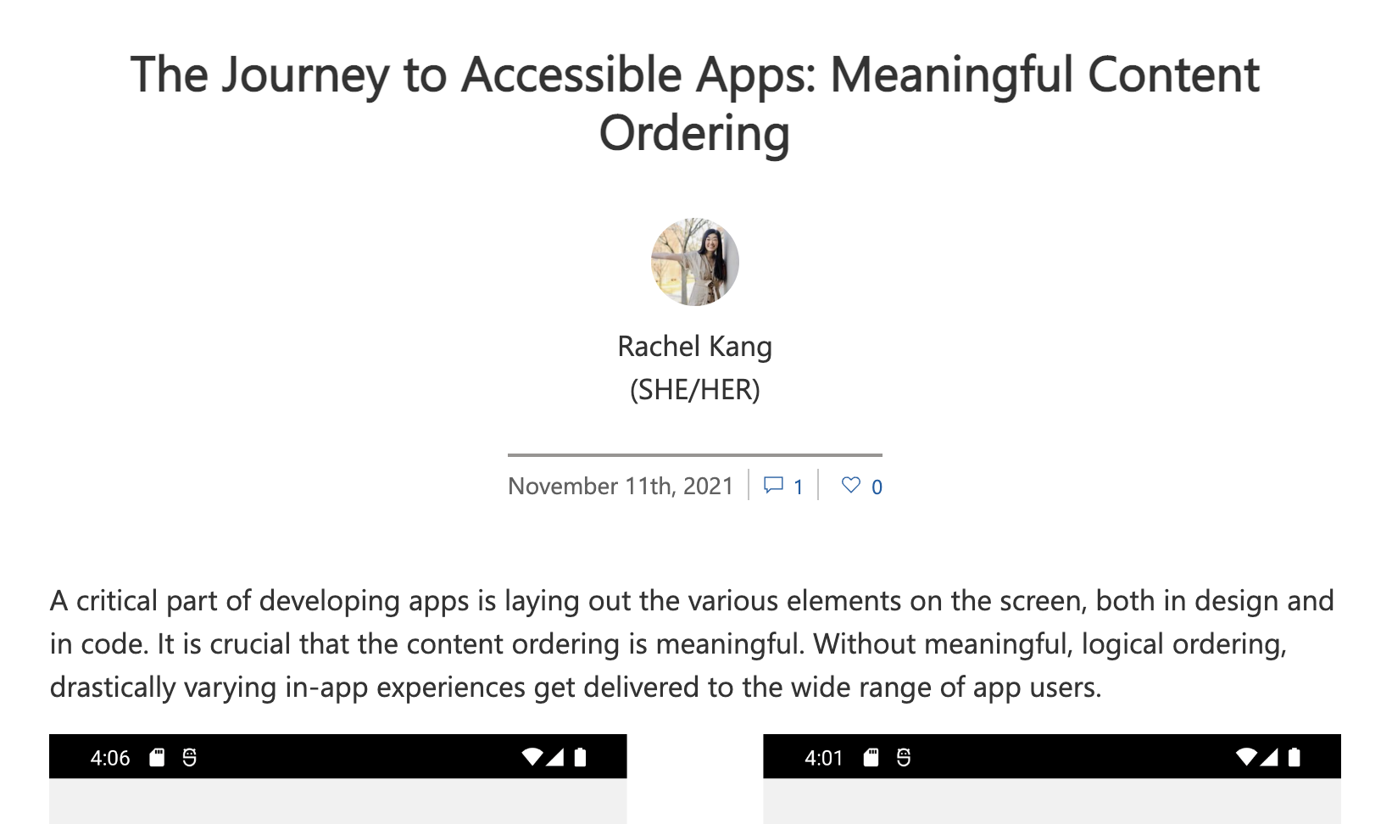
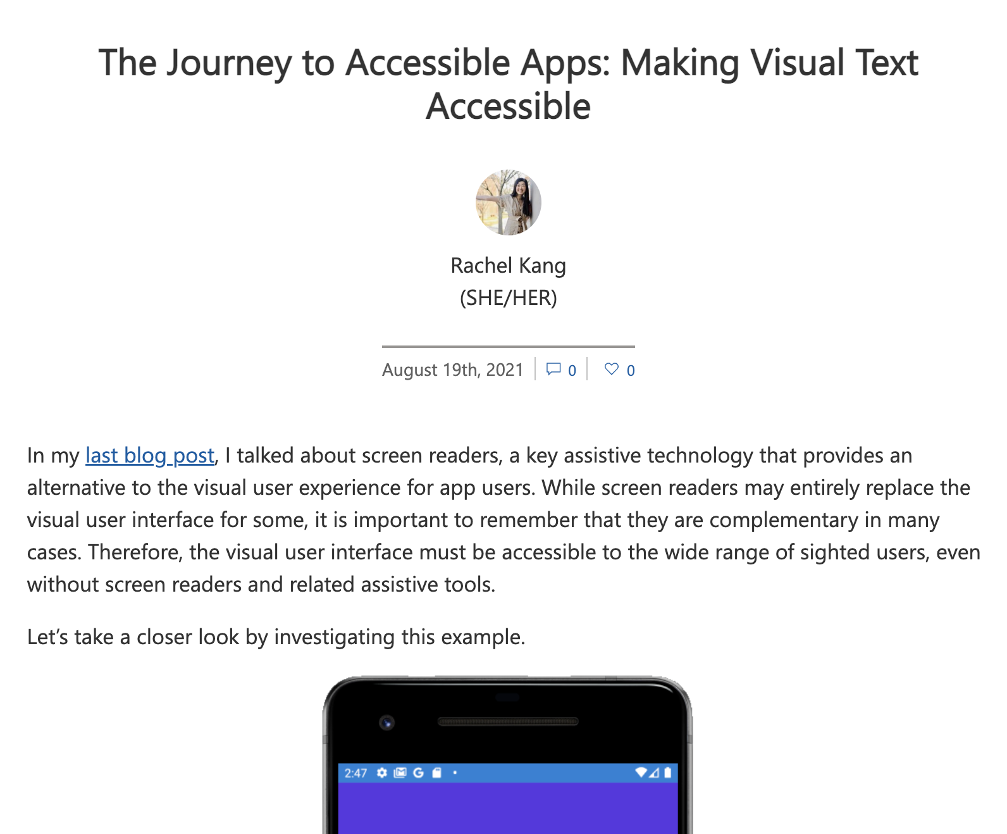
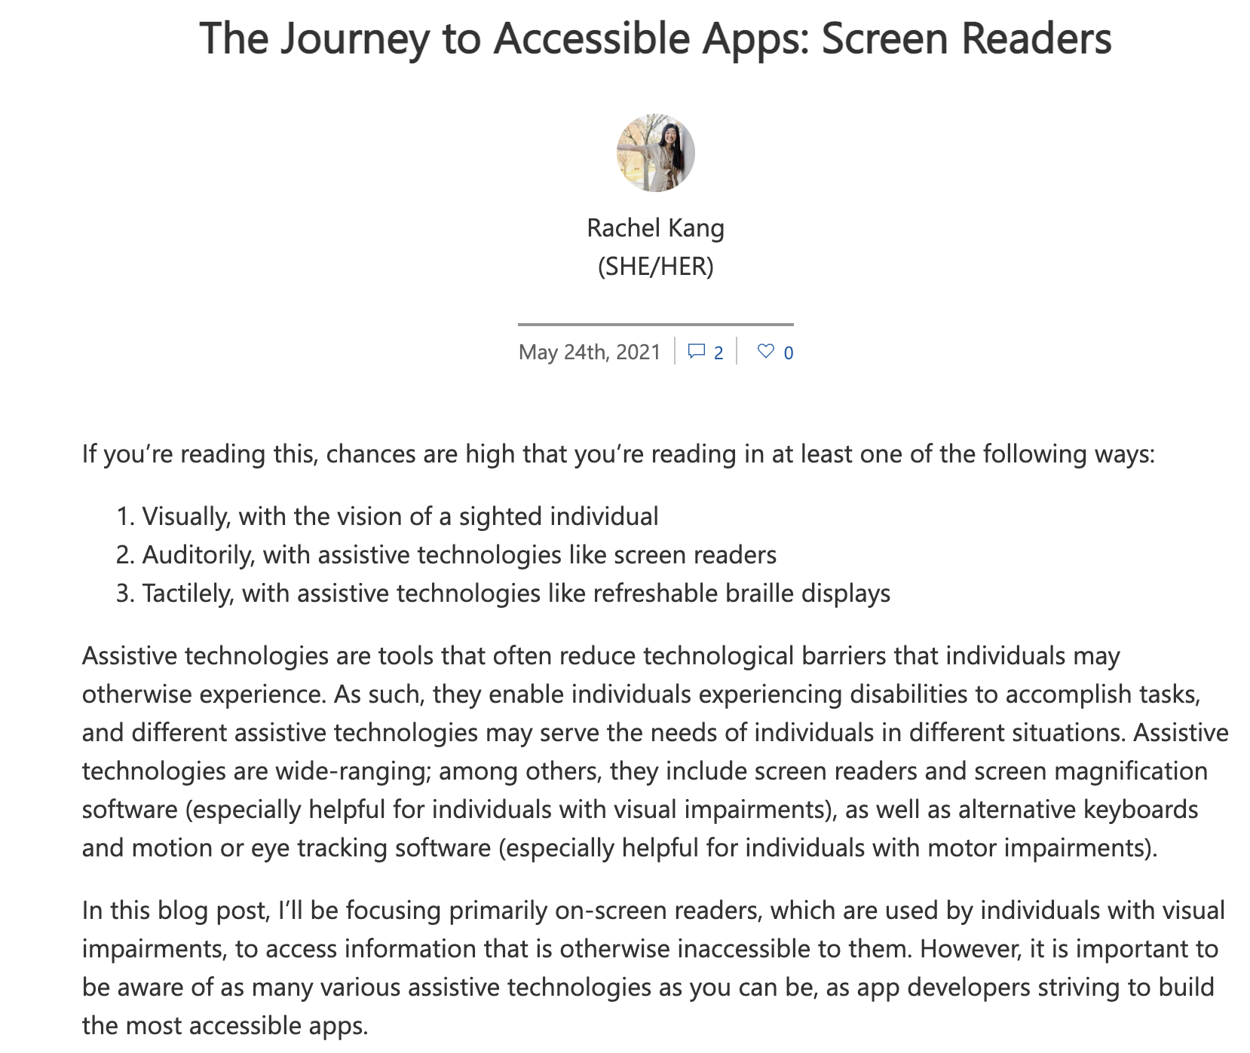
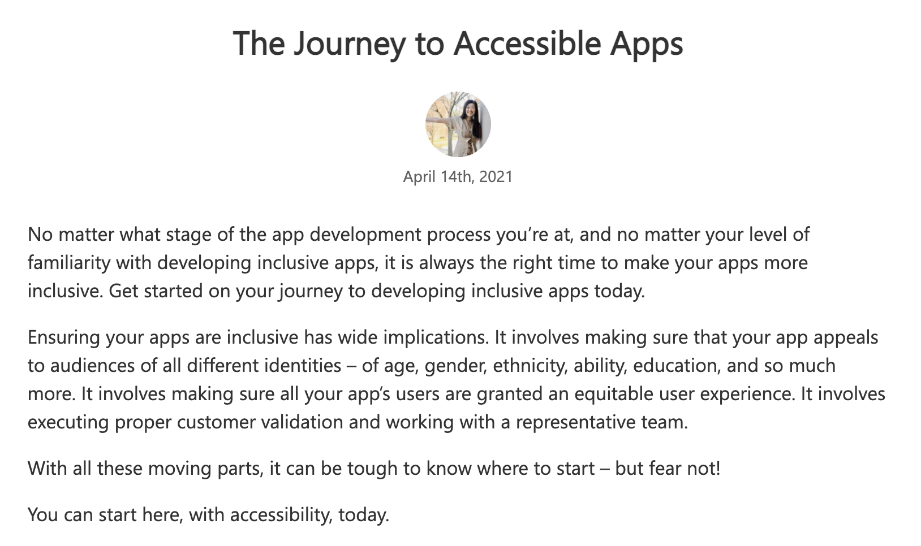
Blog post series
https://devblogs.microsoft.com/xamarin/the-journey-to-accessible-apps

Slide 34



Thank you
Thank you!
@therachelkang
@rachelkang
https://aka.ms/discord-maui > #maui-accessibility

